Slide 1
Zijia (Stella) Cao
Rapid automation – analysis for developers (RAAD)

Slide 2

Special Thank you
Intern Mentor:
Joe Tarango
Manager:
Jim Baca
Teammates:
Daniel Garces
Rogelio Macedo
Sungkeun Kim
Aghalya Manmatharaj

Slide 3
Agenda
About Myself
RAAD - Jira Cluster
RAAD - Auto Parser (FIDL)
Intel Finance - Machine Programming Recommender
Lessons Learned

Slide 4





About myself

Slide 5



Deliverable: JIRA Cluster
Generate Jira Similarity Analysis and Clustering in RAAD Report
Jira Cluster: Find similar root cause of required asserts in the Jira database and generate a report for reference, start testing from DE003
Separate the Jira cluster process (Phase2+Phase3+Phase10) from the whole RAAD system and turn it into a mode named ‘JIRACluster’
Phase 2: Parse binary files
Phase 3: Gather debug handbook data
Phase 10: Execute Jira mining
Make Jira cluster an API

Slide 6
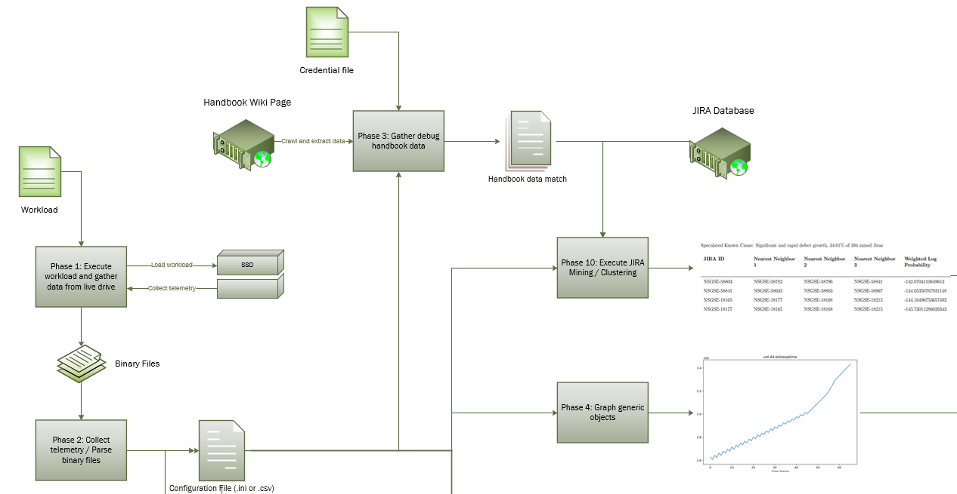

Slide 7
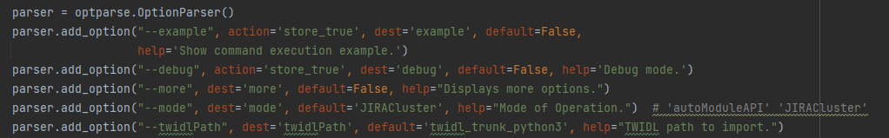
Deliverable: JIRA Cluster
Integrate JIRACluster into RAAD as A New Mode

Slide 8
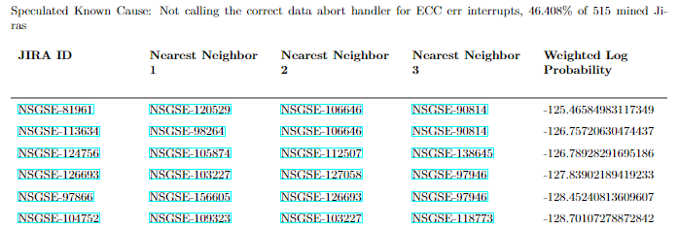
Deliverable: JIRA Cluster
Generate Jira Similarity Analysis and Clustering in RAAD Report

Slide 9
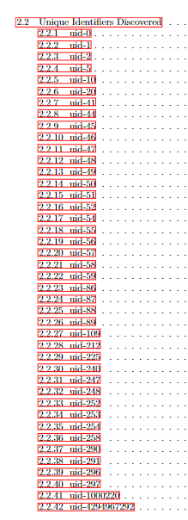
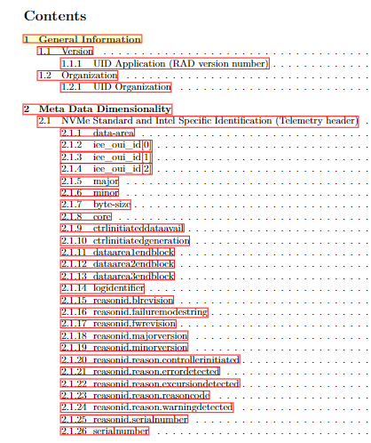
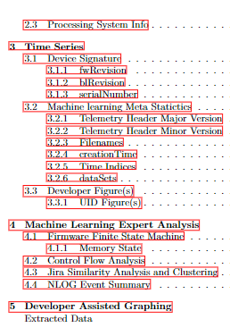
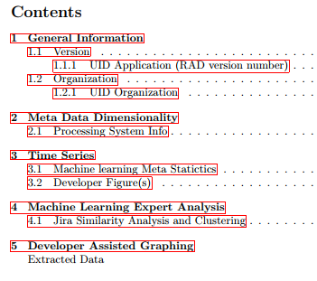
Deliverable: JIRA Cluster
Table of Contents for RAAD Report
DF049:
DE003:

Slide 10
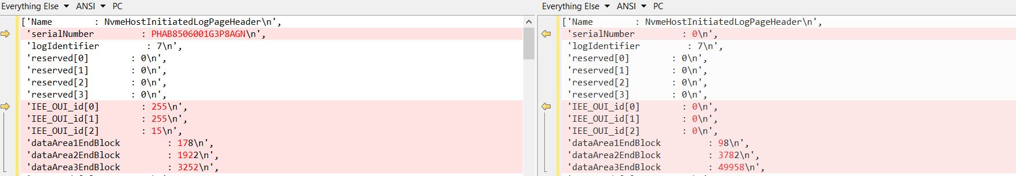
Challenge: Speculated root cause
DF049 (ADP) - telemetry version 2
DE003 (ADP) - telemetry version 3
1.
2.
Issue 1: Serial number does not exist
Issue 2: IEE_0UI_ids have not yet been prepared

Slide 11
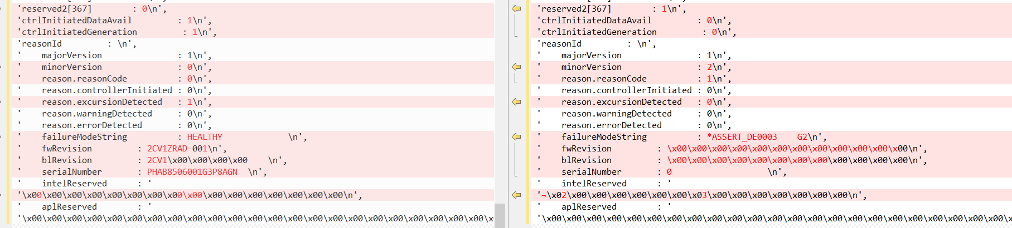
Challenge: speculated root cause
DF049:
3.
DE003:
4.
5.
6.
Issue 3: reserved2[367] field has the random value 1
Issue 4: minor version has changed
Issue 5: the serialNumber is not correct.
Issue 6: IntelReserved contains something that should not exist.

Slide 12

Challenge: Inconsistent auto parser
Why this happens?
Python 2 and Python 3 compatible issues inside auto parsers
The way to do auto parsing has been changed and we are not notified
Include TWIDL as part of the auto parsers, while TWIDL is not always stable

Slide 13
In progress: auto parser - fidl
A portable auto parser for RAAD
Replace the current manually entered telemetry object table by using machine programming
(In progress) Create a new API fidlImporter to import the parser ‘FIDL’
(In progress) Test fidlImporter on DE003 host-initiated binaries

Slide 14
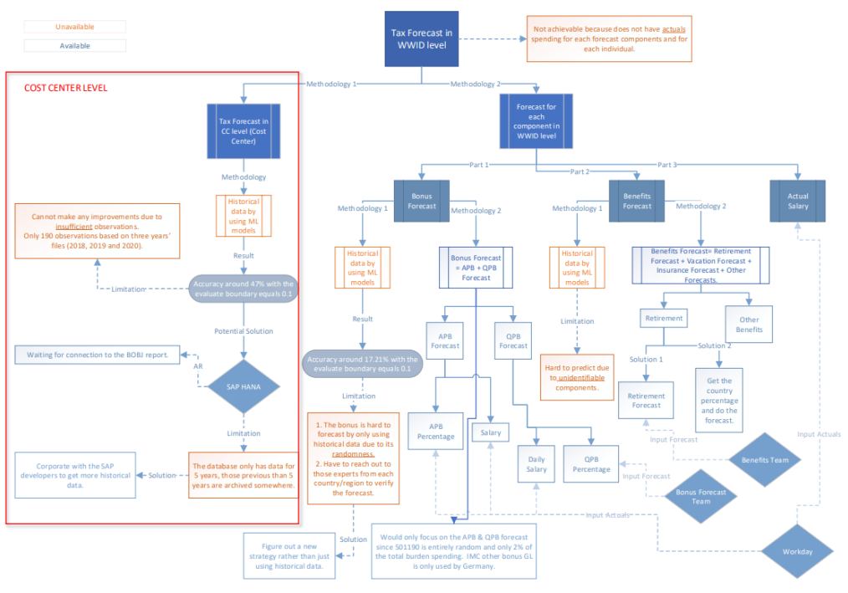
On hold: Empowering Financial Experts by using Machine Programming
Corporate with Intel Finance
Objective
Optimize the financial allocation strategy

Slide 15
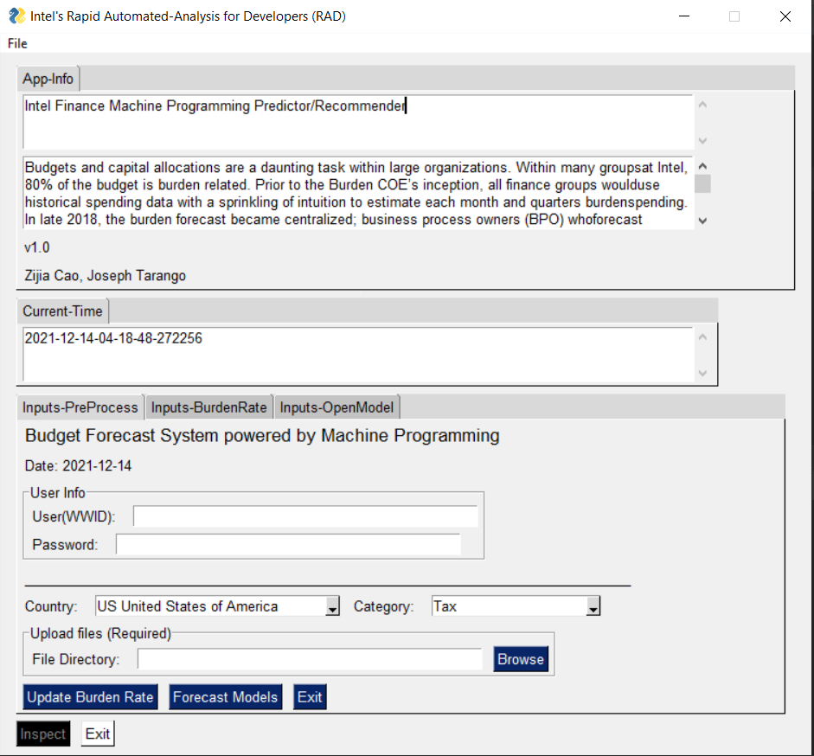
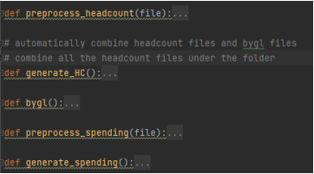
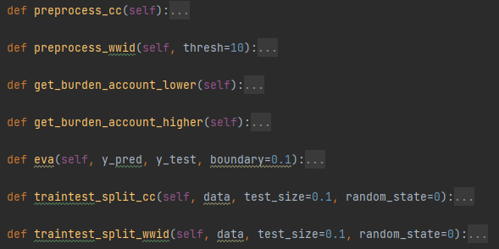
ON HOLD: Machine Programming recommender
Data Preprocessing
Identity Verification
Choose working directory

Slide 16
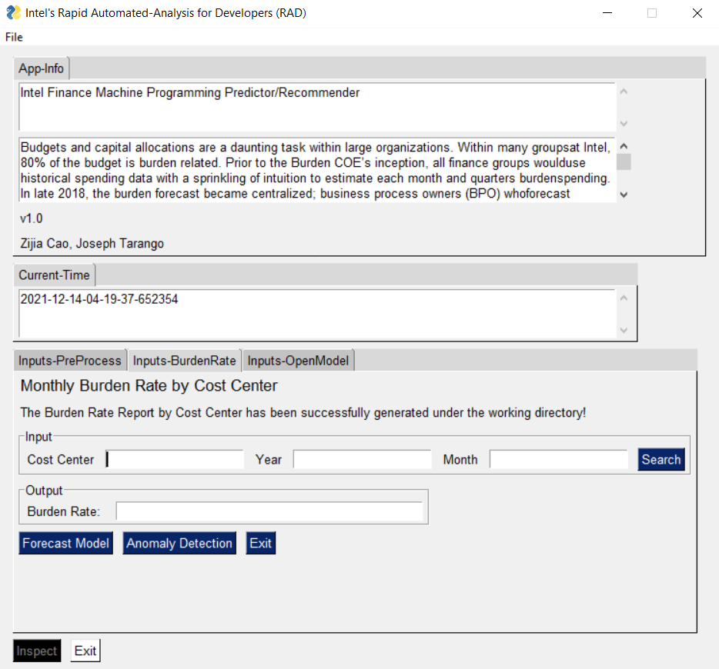
ON HOLD: Machine Programming recommender
Burden Rate Calculation
Burden Rate = Spending / Headcount
Search burden rate by inputting some basic info

Slide 17
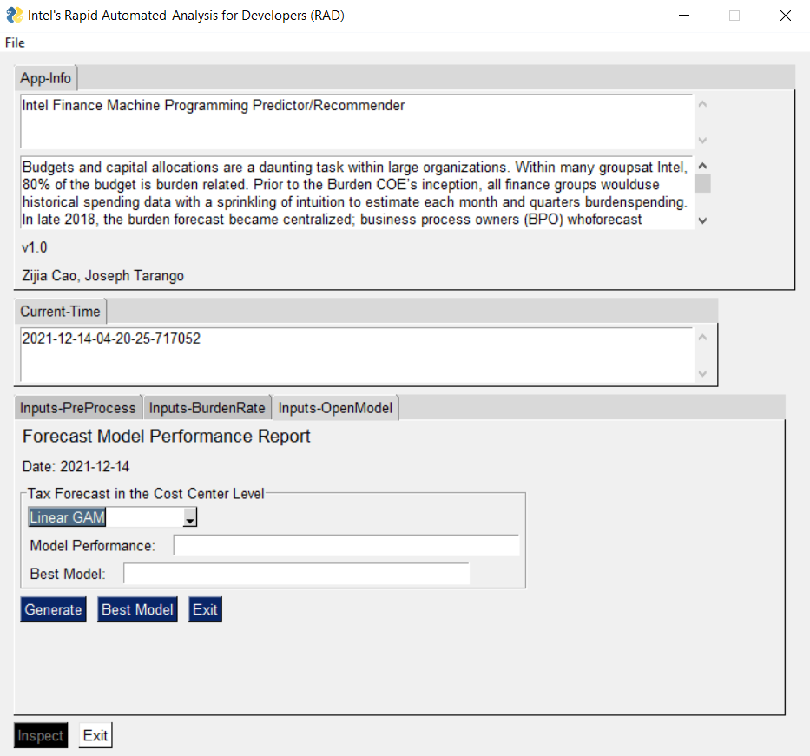
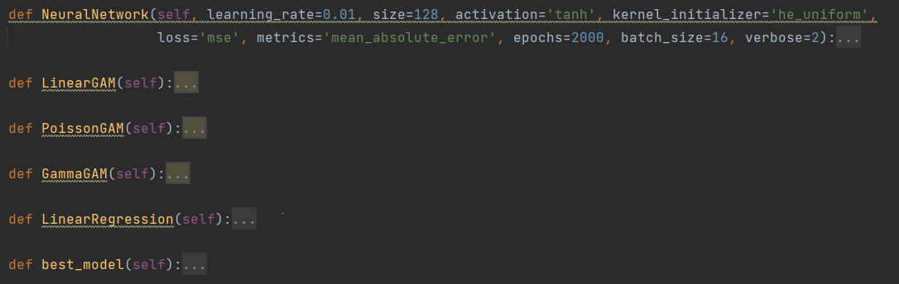
ON HOLD: Machine Programming recommender
Corporate with Intel Finance
Selected model performance
Best model suggestion

Slide 18
Lessons learned
Learn through ambiguity.
Be open and curious to new possibilities.
Cross-team collaboration.

Slide 19



Key Learning Points
Academic
Professional
Personal
Machine Programming
Reverse Engineering
Compiler
Linux System Operations
Debug in Pycharm
Grasp a concept/program quickly
Speculate the root cause before debugging
Cross-team collaboration
Pathfinding will not always give you a result
Multitasking
Always show respect to others

Slide 20
THANK YOU

Slide 21


